Slide 1
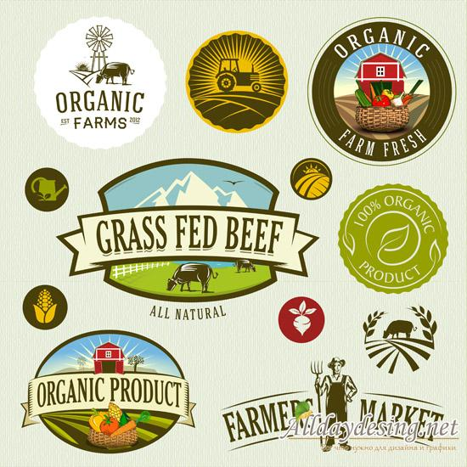
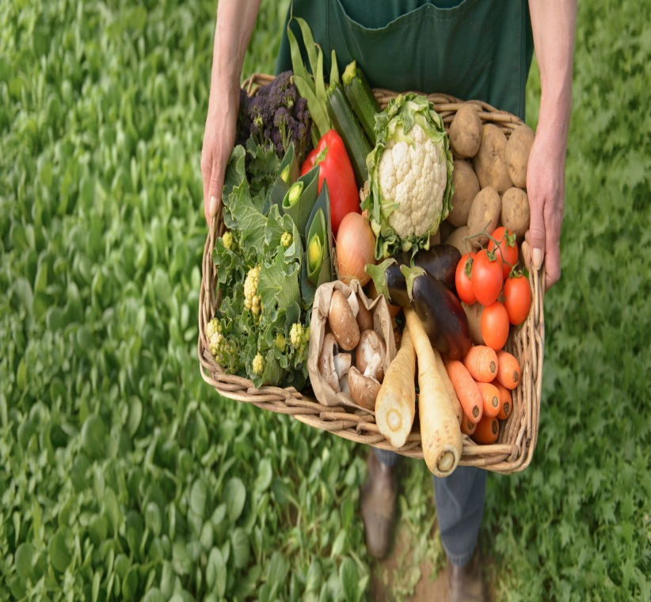
Why organic farming?

Slide 2
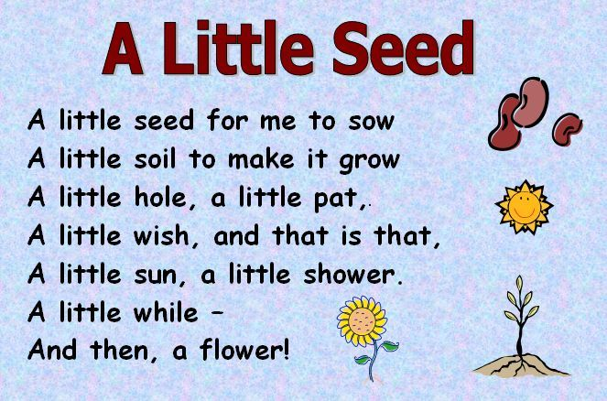

Slide 3
“Tell me what you eat and I will tell what you are”
Anthelme Brillat-Savarin, French lawyer and politician

Slide 4
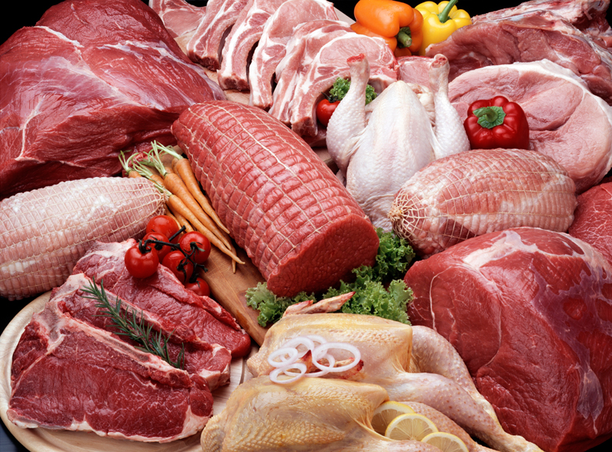
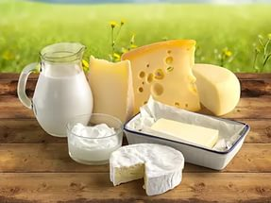
FAT.

Slide 5
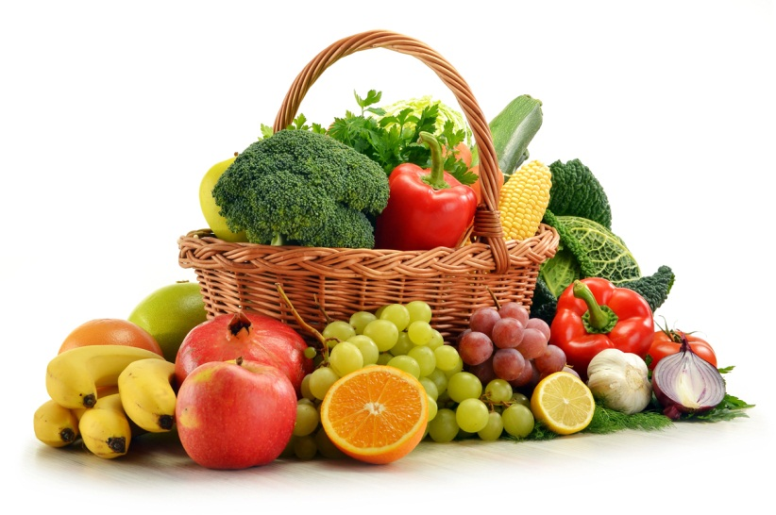
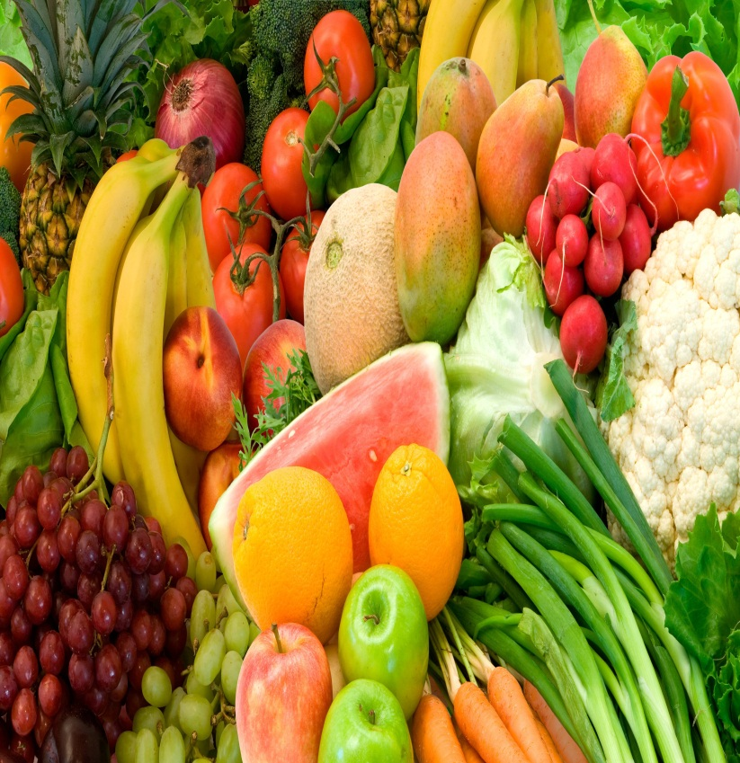
Carbohydrates.

Slide 6
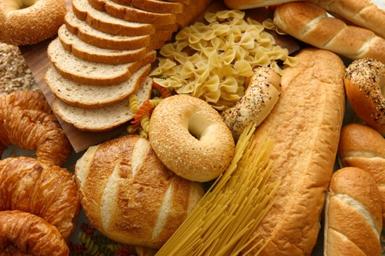
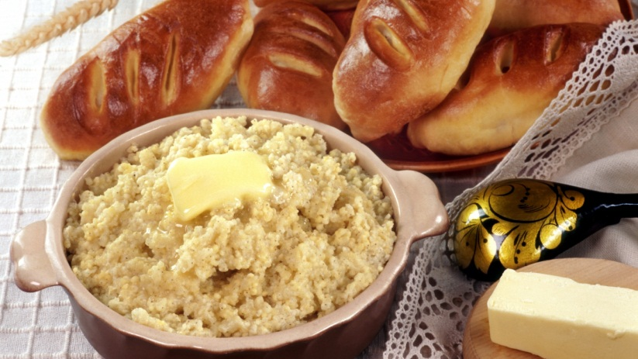
Protein.

Slide 7
1. Meat | a) builds strong teeth and bones by providing Calcium.
2. Dairy | b) helps us to have strong and healthy body by providing protein.
3. Fruits and vegetables | c) are fast sources of energy.
4. Bread and cereal | d) help us to have healthy gums, good eyesight by providing Vitamins A and C.
5. Fats and sugars | e) gives us energy by providing protein, iron, and several B vitamins.

Slide 8
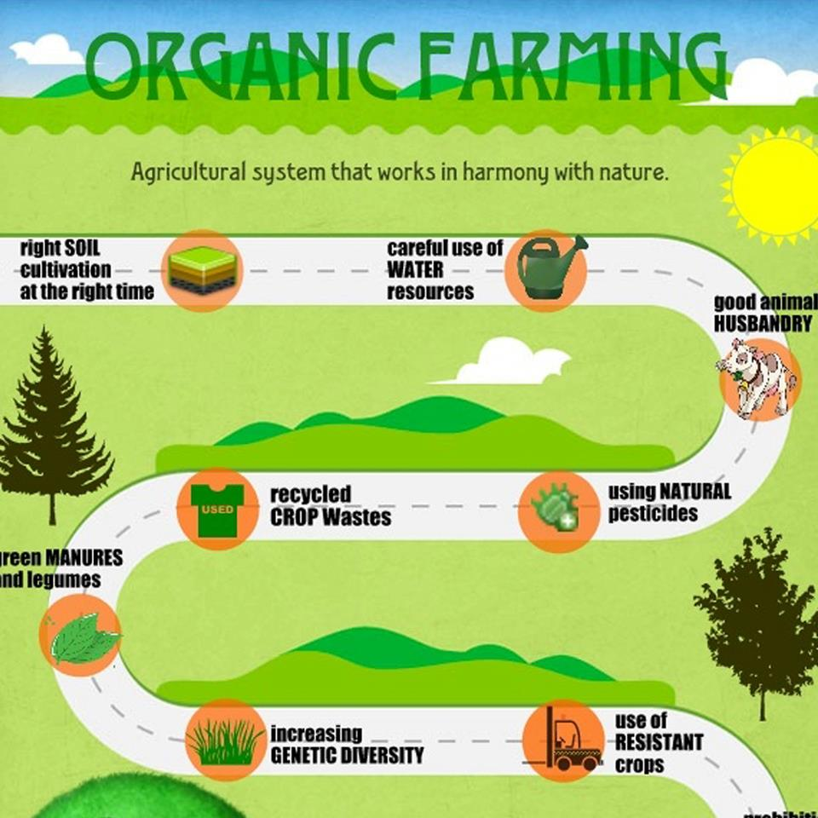
Organic farming.
Organic farming is a form of agriculture that uses only natural products to help the plants or animals grow.

Slide 9
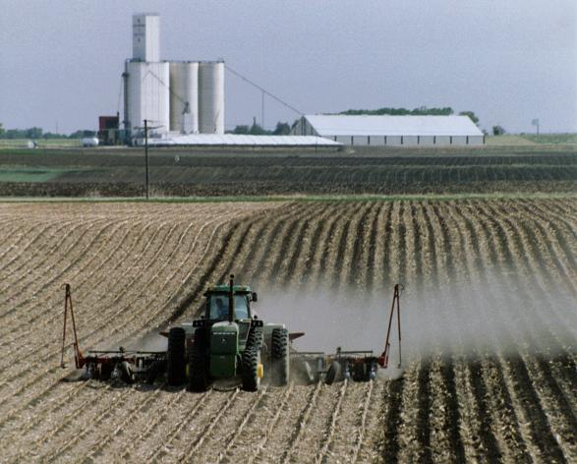
Conventional farming.
Conventional farming, also known as industrial agriculture, refers to farming systems which include the use of synthetic
chemical fertilizers, pesticides,
herbicides and other continual inputs, genetically modified organisms, Concentrated Animal Feeding Operations, heavy irrigation, intensive tillage, or concentrated monoculture production. Thus conventional agriculture is typically highly resource and energy intensive, but also highly productive.

Slide 10
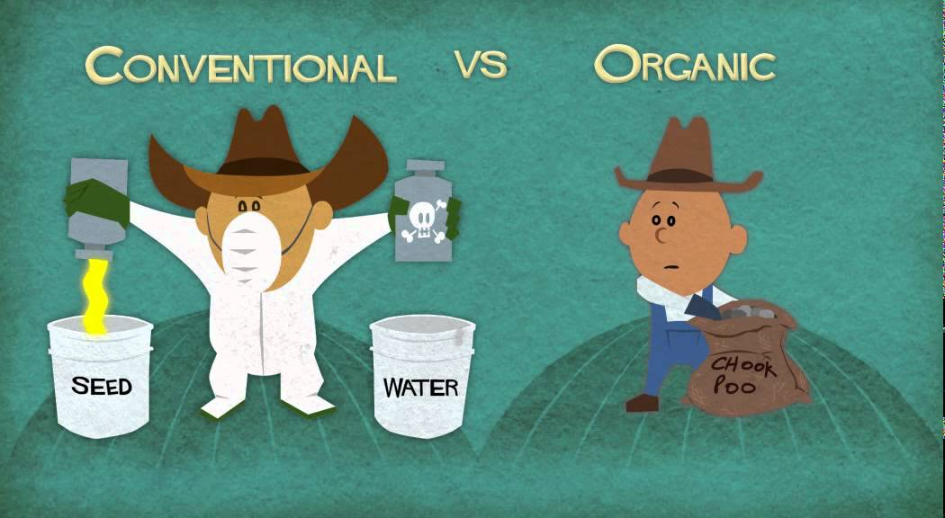

Slide 11
Organic
Farming
Conventional Farming
Organic farming minimizes chemical usage
Organic farming promotes biodiversity
Soil health is improved with organic farming practices
Only natural methods are used in organic farming
Conventional farming makes use of chemicals, synthetics, and other materials to manage weeds and pests
Conventional farming uses unnatural farming methods
Conventional farming use of pesticides has garnered attention towards acceptable levels of toxicity, and whether there should actually be an acceptable level
Pesticides used in conventional farming can be damaging to your health.

Slide 12
A little seed for me to sow . . . (Pretend to hold a tiny seed.)
A little earth to make it grow . . . (Stoop down and touch the ground.)
A little hole, A little pat . . . (Pretend to dig a hole; plant seed; pat earth around seed.)
A little wish, And that is that. (Touch index fingers to head; bring arms down and fold over chest.)
A little sun, A little shower . . . (Make sun with hands; use fingers to create rain.)
A little while, And then — a flower! (Pretend to sleep; cup hands around face like flower.)

Slide 13
Tractors: vehicles farmers use for the difficult jobs around a farm flame
Weeders: gadgets that burn the weeds/ plants that farmers don’t want/need and which can damage other plants
Crops: what a farmer grows e.g. potatoes
Maintain: to keep in the same condition/state
Richness: the good quality of something
Beneficial insects: those insects/bugs that help farmers to get rid of harmful insects/bugs
Fertilisers: mixture put on plants to help them grow more successfully
Compost: natural fertilizer
Peelings: the skins of the vegetables that we usually throw away
Pesticides/insecticides: chemicals to kill insects/ bugs
Spray: to send out a liquid from a container in small drops
Intensive farming: a system whereby farmers try to produce as many plants/animals as possible from their land
Ecosystems: systems within nature
Machinery: different machines
Reduced: made less
Protect: take care of
Manure: animal droppings that help plants to grow in a natural way
Pest control: the control of different unwanted insects/bugs
Combat: fight against
Rotating crops: moving crops to different fields so as not to use up all the goodness from the land nutrients: natural substances that help animals/ plants to grow

Slide 14
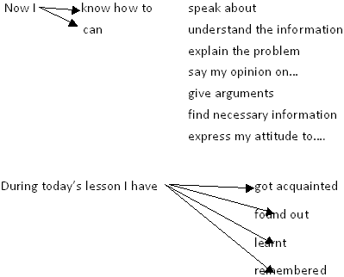

Slide 15
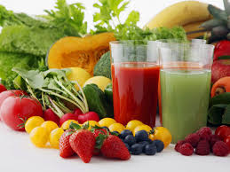
GOOD BYE!

